Slide 1
Secure data hiding in images using steganography
CAPSTONE PROJECT
Presented By: Edunet Foundation
Student Name : Shipalkar Vaishnavi Uttam
College Name & Department : ISB&M College Of Engineering, Pune.
Artificial Intelligence And Data Science.

Slide 2
OUTLINE
Problem Statement
Technology used
Wow factor
End users
Result
Conclusion
Git-hub Link
Future scope

Slide 3
Problem Statement
The problem statement is :
Secure data hiding in images using Steganography.
The project focuses on securely hiding sensitive data within images using steganography, making it invisible to the human eye. This ensures confidential communication and prevents unauthorized access or detection.

Slide 4
Technology used
In project different libraries are used which are :
CV2 library (used for reading writing images).
String library.
OS library.
The Environment is used to run the code is python IDLE (Integrated Development and Learning Environment) is Python’s default development environment.

Slide 5
Wow factors
Extra Security – Combines steganography with encryption for double protection.
Undetectable Data – Hidden information is invisible to the human eye and tough to detect.
Key-Based Access – Only authorized users with the right key can extract the secret data.
Real-World Use – Can be used for secure messaging, watermarking, and protecting confidential files.

Slide 6
End users
Government & Intelligence Agencies – Used for Securely transmit confidential information without detection.
Corporate Sector – Protect the sensitive business data and trade secrets.
Journalists & Activists – Share information discreetly in countries with censorship.
Military & Defense – Covert communication to prevent interception by adversaries.
Banking & Financial Institutions – Securely store and transmit transaction details.

Slide 7
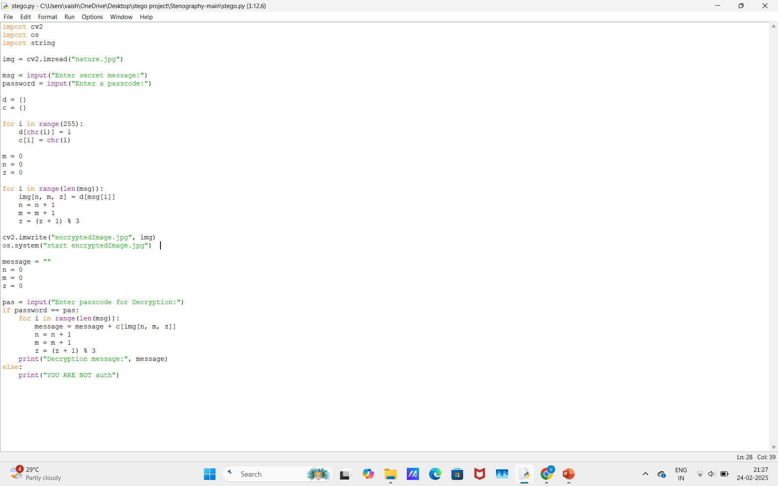
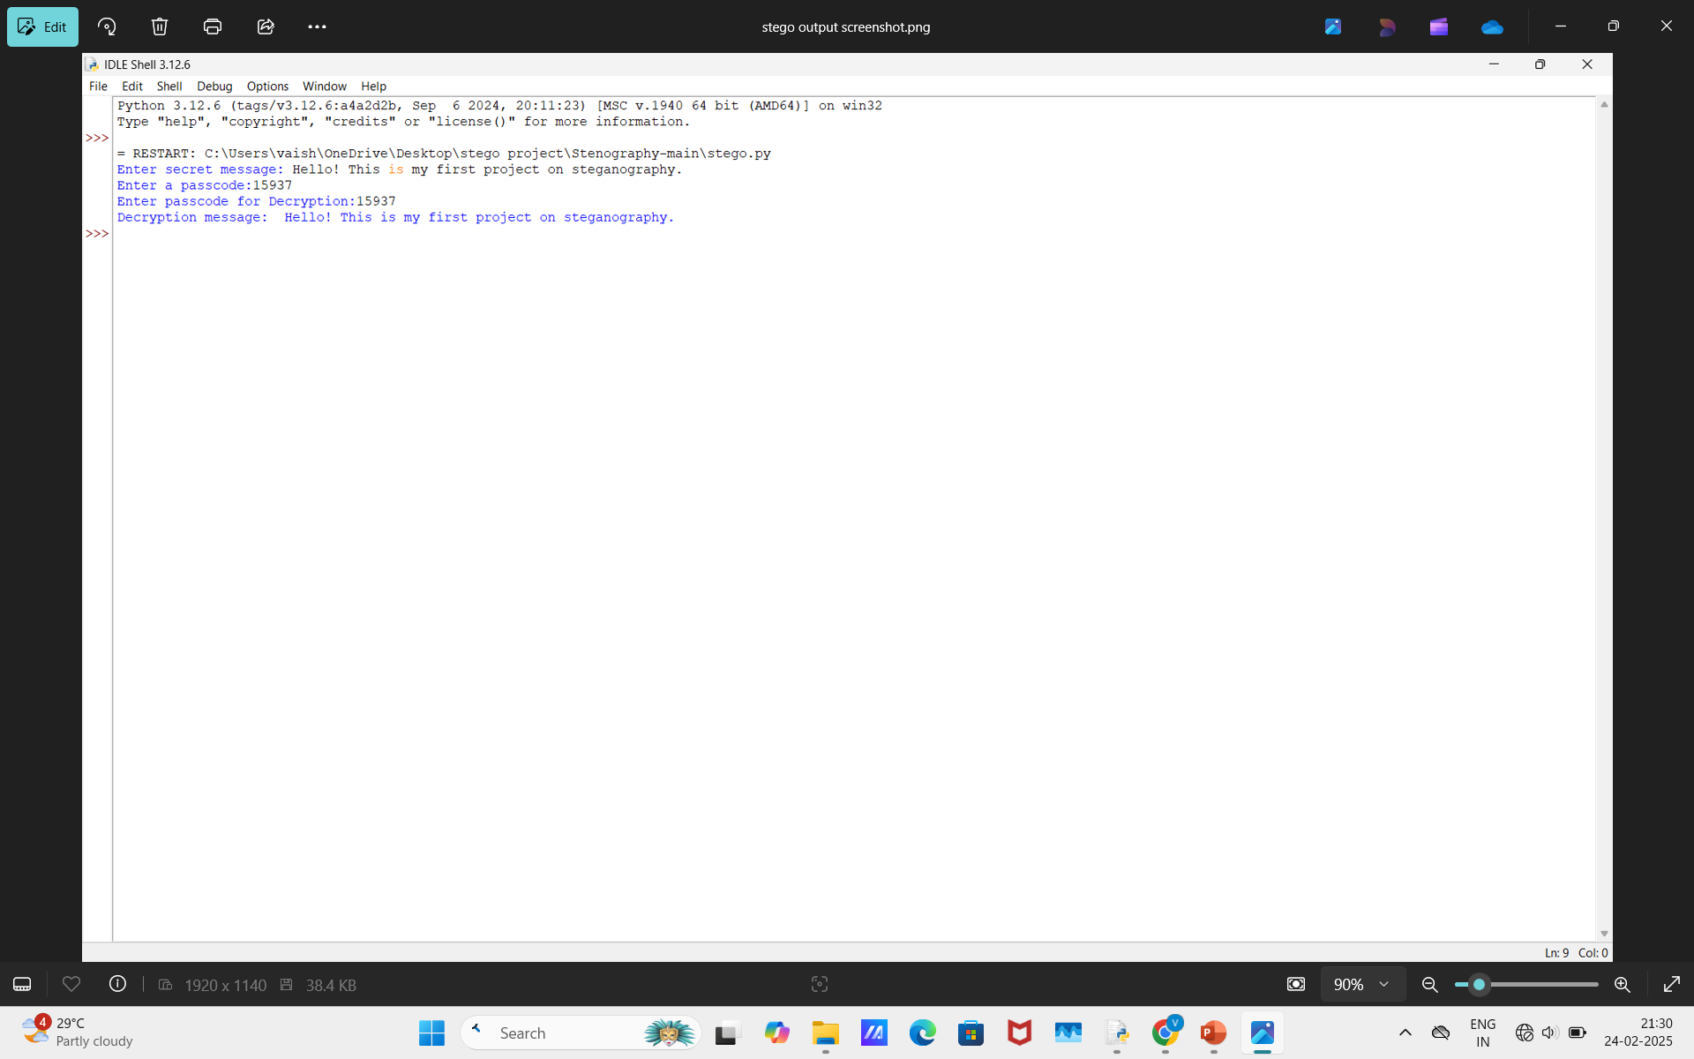
Results

Slide 8
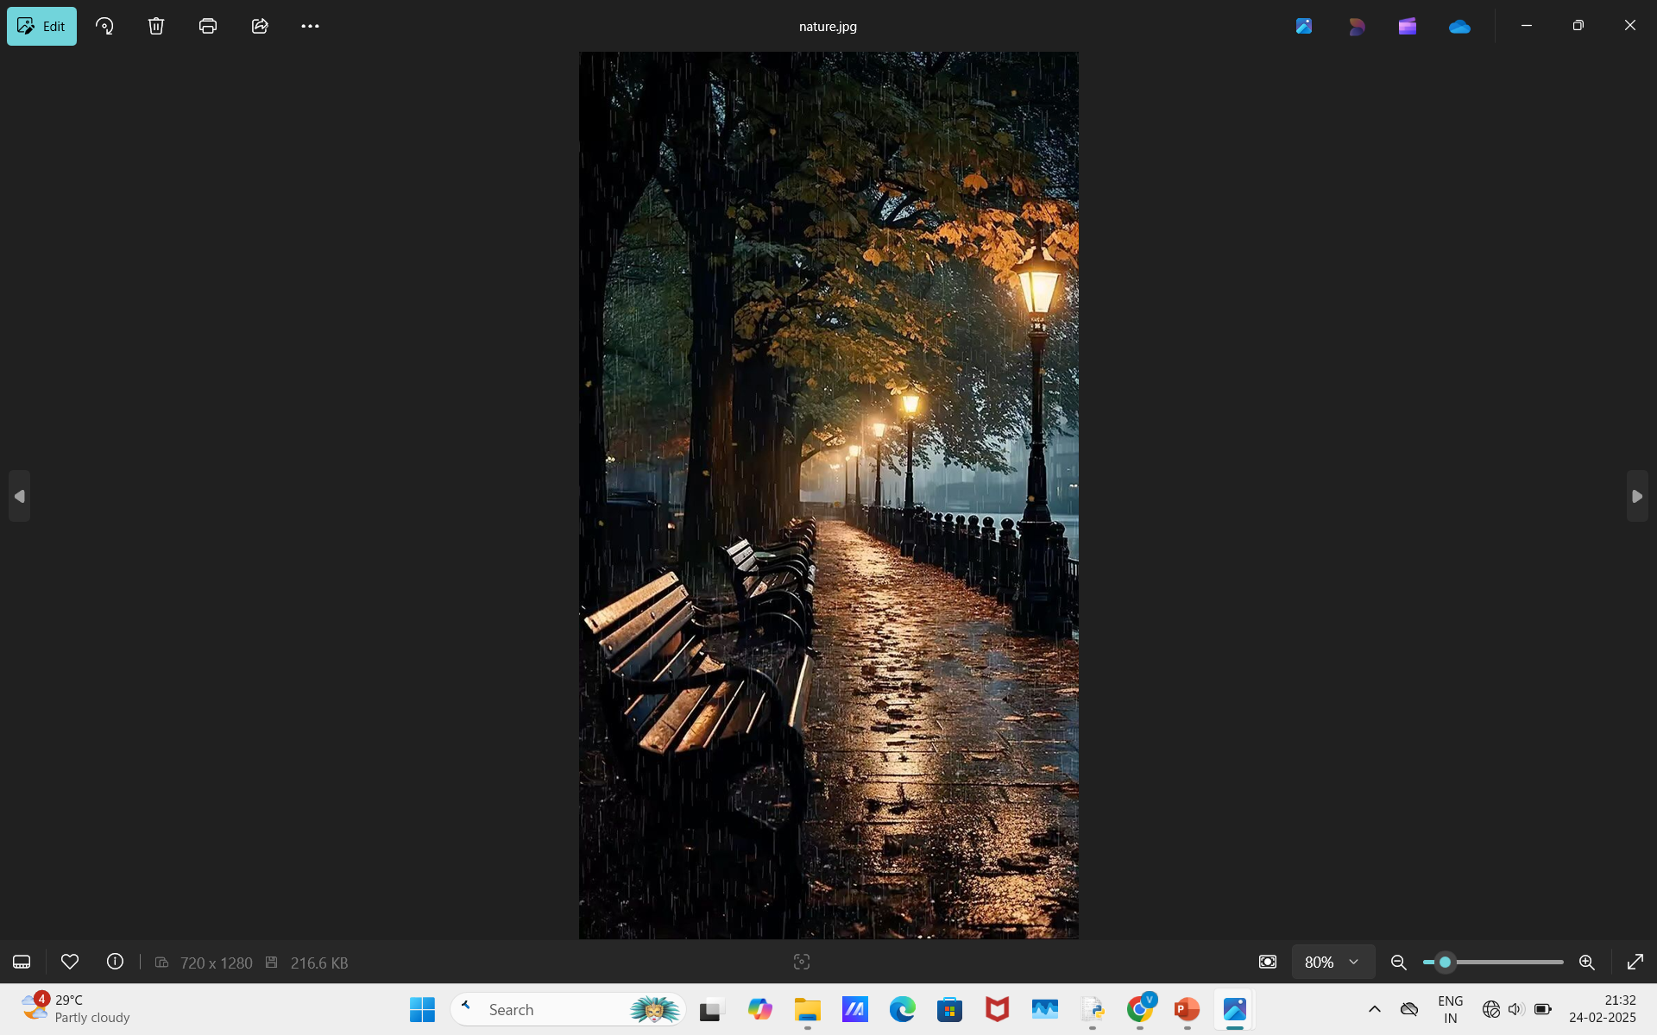
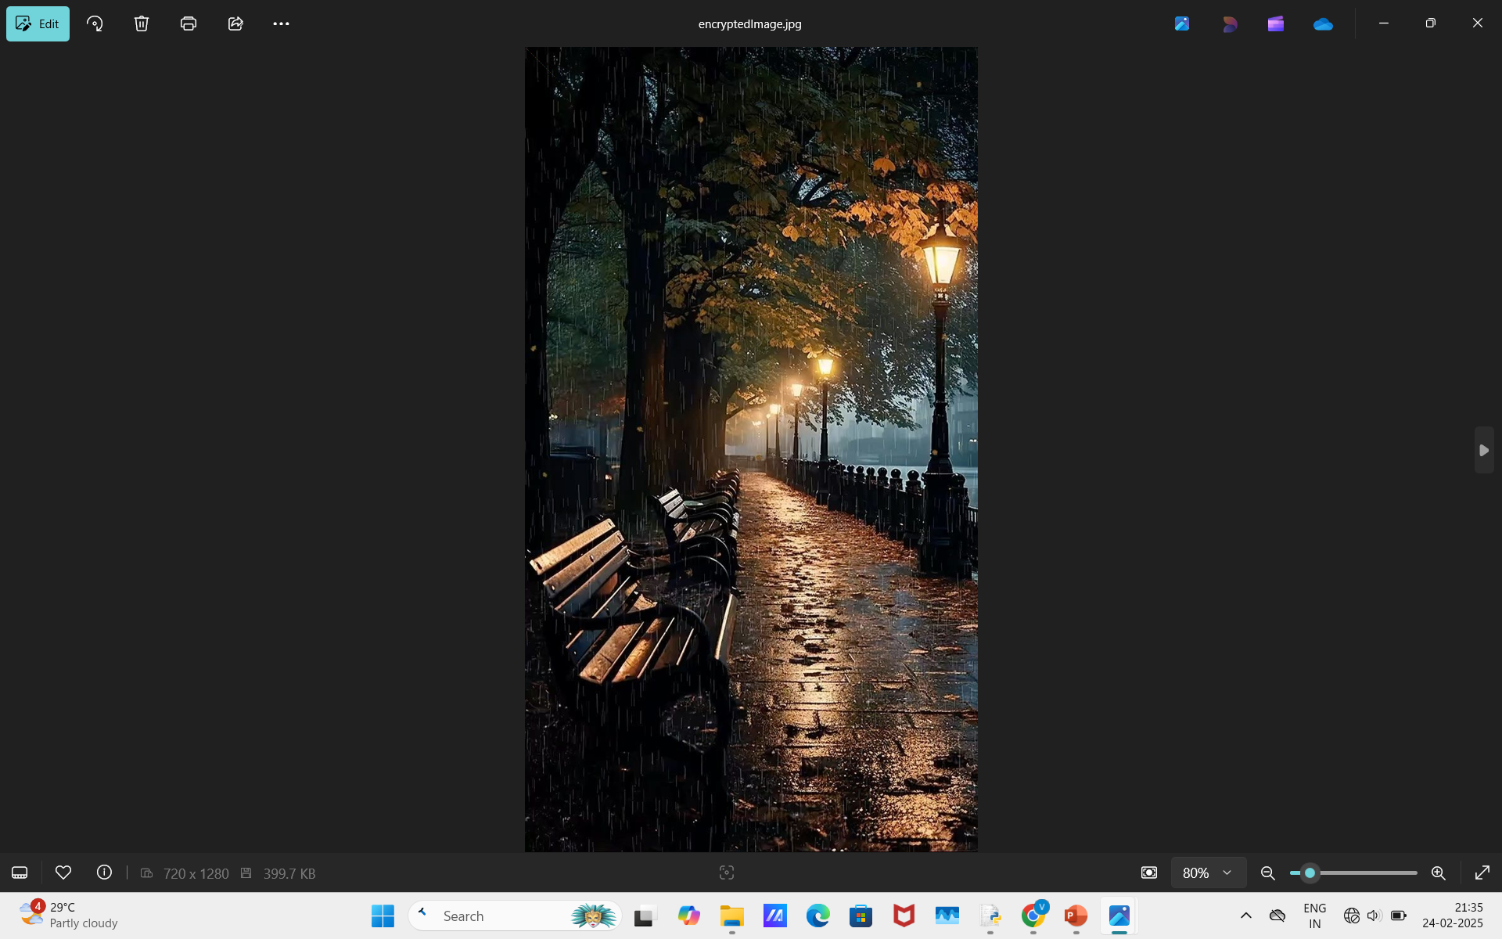

Slide 9
Conclusion
In conclusion, Secure Data Hiding in Images Using Steganography provides an advanced method for covert communication and data protection. By embedding sensitive information within images, it ensures confidentiality while remaining undetectable to unauthorized users. The combination of steganography and encryption enhances security, making it useful for government, corporate, and personal data protection.

Slide 10
GitHub Link
https://github.com/VaishnaviS307/AICTE-project-Edunet-Foundation-.git

Slide 11
Future scope(optional)
AI-Powered Steganography – Use machine learning to make data hiding even more secure and undetectable.
Real-Time Secure Messaging – Develop a system for live communication using steganographic images.
Mobile & Cloud Applications – Implement secure steganography in cloud storage and mobile apps.
Quantum Cryptography Integration – Combine with quantum encryption for next-level data protection.

Slide 12
THANK YOU

